Slide 1
The UEMS in 2017
info@uems.eu

Slide 2
Union Europeenne des Medecins Specialistes
CPD in EU
UEMS proposals

Slide 3
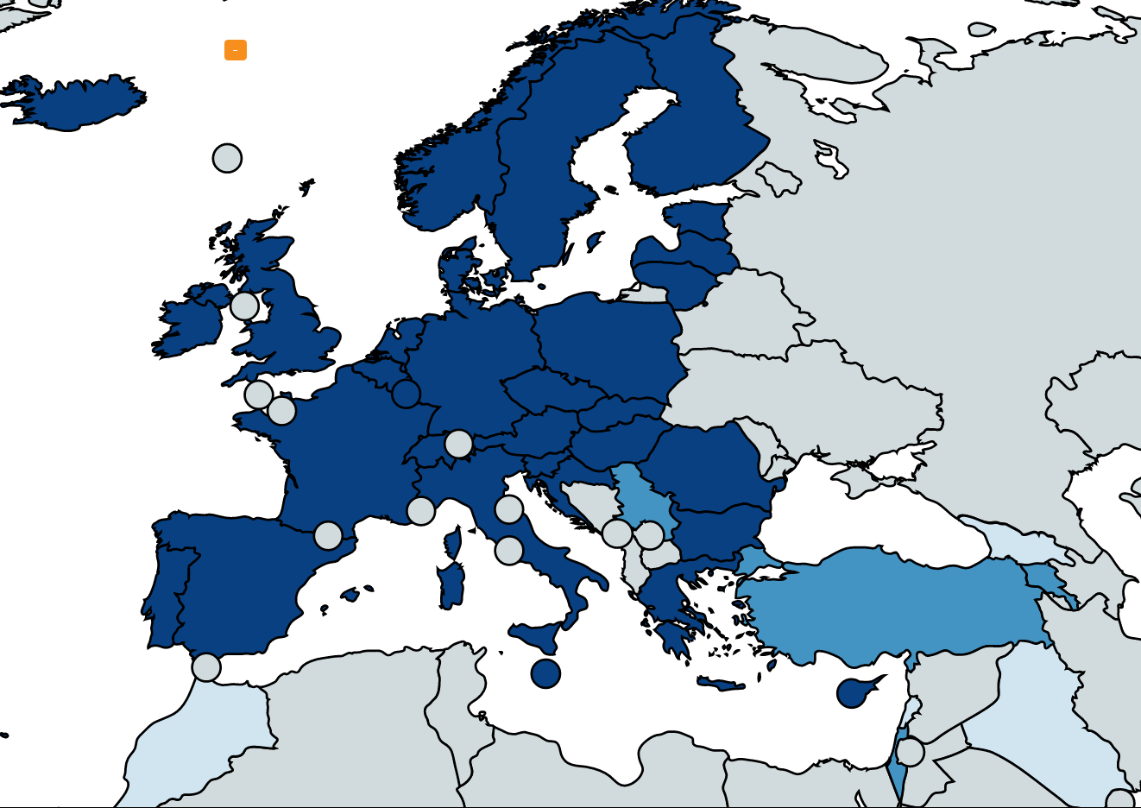
Members
59
Full Members
National Medical Associations of the 28 EU Member States & of the 3 European Economic Area Countries
Other members
4 Associate Members: Armenia, Israel, Serbia &Turkey
4 Observers: Georgia, Lebanon, Morrocco, Iraq

Slide 4
UEMS Structure
The UEMS Council:
General Assembly of Members
39 National Associations of Medical Specialists
UEMS Executive
Standing Committees
CME-CPD
Quality Assurance
Postgraduate training
EACCME
ETRs and European Exams
ECAMSQ
UEMS Bodies
43 Specialist Sections
15 Multidisciplinary Joint Committees
3 Thematic Federations
European Boards
Divisions
Working Groups
CME-CPD
E-health
Specialist Practice & Quality of Care
Postgraduate training

Slide 5
UEMS Specialist Sections
UEMS Council
Advisory Board
I
Medical Specialties
II
Surgical Specialties
III
Other Specialties
Chair
Chair
Chair
UEMS Executive

Slide 6
Postgraduate Training (PGT)
Harmonisation of the specialist training and CME through interdisciplinary European collaboration
high level of specialist professional competence and medical care in Europe
Continuing Medical Education (CME)
Quality Assurance in Specialist medical practice

Slide 7
UEMS Achievements
European Training Requirements (in collaboration with European Scientific Societies)
European Examinations (in collaboration with European Scientific Societies)
UEMS EACCME - criteria for CME quality implemented in accreditation of International CME
Effective interdisciplinary cooperation on voluntary basis

Slide 8
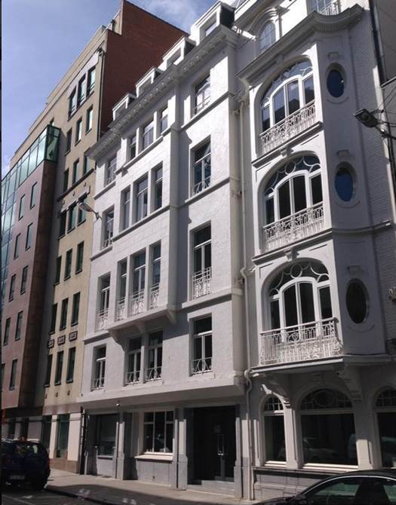
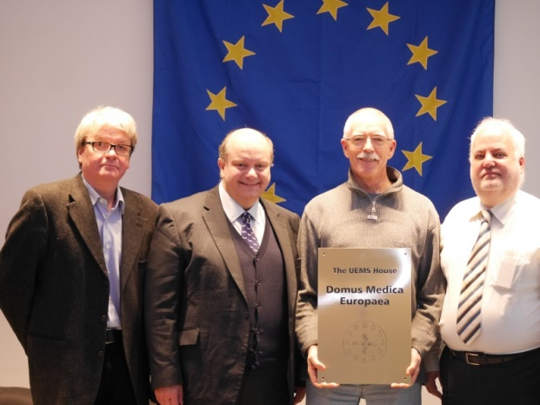
UEMS Achievements
Managing complexity
The UEMS House - Domus Medica Europaea
UEMS EACCME 2.0
New Rules of Procedure 2017
Growing membership

Slide 9
CPD and CME in Europe

Slide 10
CPD regulation in EU
Definition?
EU Mapping Study on CPD

Slide 11
Definition
CPD - all educational activities by a physician that occur after obtaining the license to practice medicine
PGT - training to obtain a title of specialist
CME - educational activities (LEE, ELM, …)
… - subspecialty/special competence training
… - assurance of quality of practice

Slide 12
Subsidiarity vs harmonisation
Subsidiarity is the guiding principle in organisation of health care services.
Professional and patients mobility, and differences in healthcare systems call for harmonisation.

Slide 13
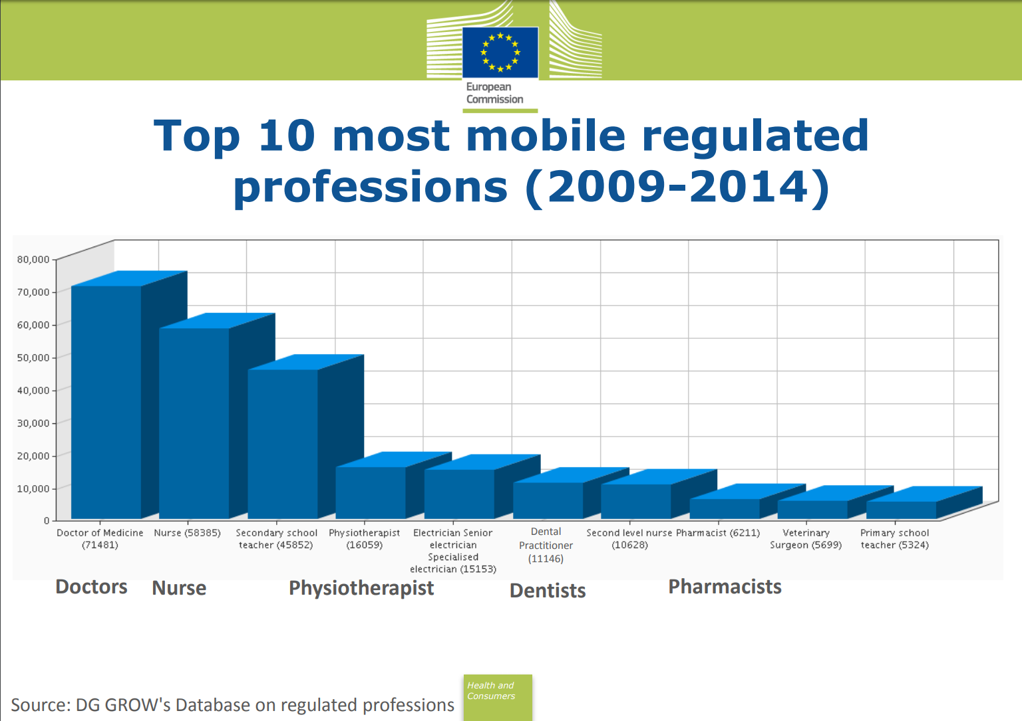
Professional Qualifications Directive
Big political achievement
Opportunities for healthcare professionals

Slide 14
Professional Qualifications Directive
Based mostly on training duration
Limited number of "common" specialties
Important differences in professional competence
Headhunting and shortages of staff
Notes:
Overall - very successful

Slide 15
UEMS proposal
Voluntary harmonisation
European Training Requirements for PGT
Competence-based
Common Training Frameworks
European Examinations
European Professional Card

Slide 16
European CME
Mandatory with sanctions
Mandatory without sanctions
Mixed mandatory and voluntary
Voluntary
No formal CME structure

Slide 17
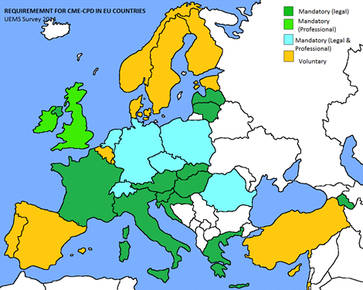
European CME

Slide 18
CPD/CME in Europe

Slide 19
3. … There is no evidence to suggest there is a single best way to regulate CPD. However, regardless of the system, it is highly desirable for the profession to be responsible for CPD. …
5. … irrespective of the nature of the healthcare system … time and resources must be allocated to ensure that doctors are able to take part in CPD.
6. There is a lack of evidence that recertification or revalidation methods are helpful in the detection of poorly performing doctors or making healthcare safer. … overregulation at EU or national level will not enhance professional mobility and will not assure cross-border quality of care.
8. To assure unbiased CPD the Medical profession must take responsibility for the approval and/or accreditation of CPD activities.

Slide 20
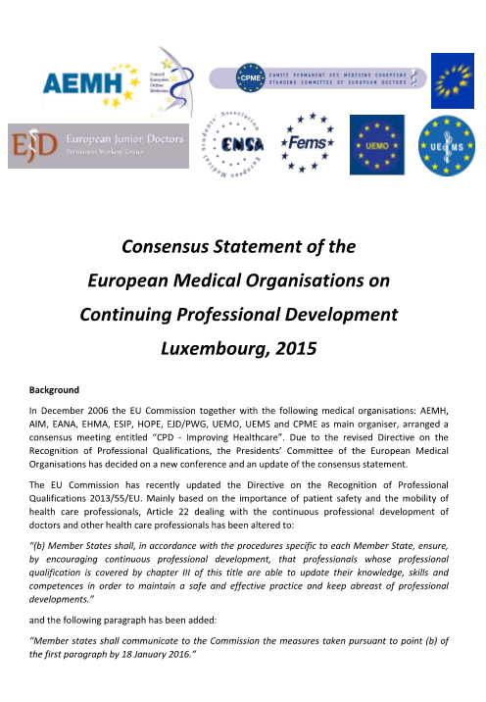
European CME
Ethical obligation
Some degree of formalisation is necessary
No single best way to organise and regulate CPD/CME
Healthcare systems have to support CPD/CME
Notes:
CME must not become a reporting duty - this will turn its purpose upside down. The incentive should be provision of the best care that will reinforce patients' trust in individual doctor and in the profession.

Slide 21
UEMS proposal
European platform
Voluntary harmonisation
EACCME 2.0
common stringent criteria for quality CME
facilitated international recognition of CME credits
inclusion of modern, innovative CME formats
Notes:
Self-regulation effort, avoidance of commercial bias, nobody can accredit himself, multiple engagements are common and organization has to assure as much independence as possible

Slide 22
Professional competence in EU
Recertification, revalidation, MoC, …
Formal systems: BE, DE, HU, NL, SL, UK
Majority - CME/CPD based
360⁰ assessment, complaints, compliments, practice patterns
Administrative and self-regulation systems

Slide 23
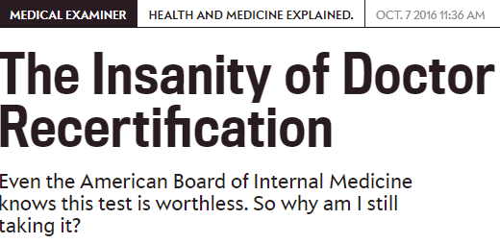
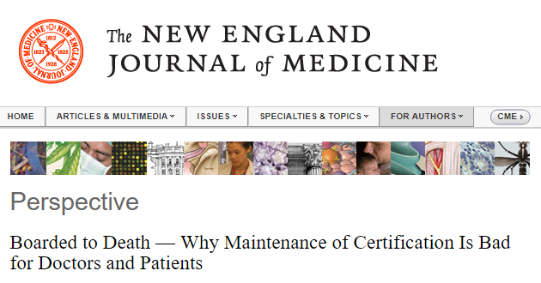
Professional competence
"There is lack of evidence that recertification or revalidation methods are helpful in the detection of poorly performing doctors or making healthcare safer. … overregulation at EU or national level will not enhance professional mobility and will not assure cross-border quality of care."

Slide 24
UEMS proposal
Participation in a good quality CME is sufficient to maintain professional competence.
European platform is needed to support professional mobility.
Regulation of requirements has to remain in the hands of medical profession.
Notes:
Proposal to introduce a higher voluntary level for those who pass European exam and European Council for CPD.

Slide 25
Collaboration
Quality CME
Harmonisation of European Training Requirements (general and subspecialty)
European examinations

Slide 26
European medical certification - rules and responsibilities
Collaboration of European doctors aimed at harmonisation of professional competence, maintanance of skills and knowledge, preservation of responsible professional autonomy and self-regulation.

Slide 27
European collaboration
Rome Declaration: "We will make the European Union stronger and more resilient, through even greater unity and solidarity amongst us and the respect of common rules. Unity is both a necessity and our free choice. Taken individually, we would be side-lined by global dynamics. Standing together is our best chance to influence them, and to defend our common interests and values. We will act together, at different paces and intensity where necessary, while moving in the same direction, as we have done in the past, in line with the Treaties and keeping the door open to those who want to join later. Our Union is undivided and indivisible." "We will pursue these objectives, firm in the belief that Europe's future lies in our own hands and that the European Union is the best instrument to achieve our objectives."

Slide 28
European collaboration
We need more collaboration and more common rules.
Erasmus + for trainees
Annex V updates
Implementation of Luxembourg Statement
Cooperation with European Scientific Societies
Cooperation with EMOs

Slide 29
The Added Value of Collaboration
European excellence in key areas of relevance to the medical profession based on voluntary effort of medical specialists
Interdisciplinary approach to all areas of specialist medical practice
Development of harmonised models for the training and CPD of the next generation of medical specialists
Effective interaction among individual specialities and National Medical Associations

Slide 30
UEMS challenges for the future
Promoting cooperation among medical specialists, doctors and medical professions
Harmonisation of CME/CPD in Europe
Harmonisation of PGT and implementation of European Training Requirements and European Examinations
Supporting educational and professional mobility
Keeping quality assurance of medical specialist practice in the hands of our profession
Protecting professional autonomy of medical specialists

Slide 31
THANK YOU FOR INVITATION
www.uems.eu
info@uems.eu

